Slide 1
M&A as Transformer of the Automotive Industry - SoSe 26
Valuation of TRATON SE
Is Traton correctly valued by the market?
Valuation date: June 30, 2026 | Data: Bloomberg, LSEG, company disclosures up to Q1 2026
MATA Seminar - Valuation Day | Jakob Frank

Slide 2
Valuation results - overview
Traton appears substantially undervalued across all methods applied
EUR 33.18
Share price 30/06/2026
EUR 45-78
Multiples valuation range
EUR 77-111
DCF sensitivity range
EUR 34.40
Avg. analyst target
Method | Key result | Implied value / share | vs. price
DCF (FCFF, WACC 7.1%, g 1.5%) | Firm value EUR 51.7bn; equity EUR 44.9bn | EUR 89.81 | +171%
EV/EBITDA 2026E (peer median 5.1x) | Implied EV EUR 29.3bn | EUR 45.05 | +36%
EV/EBITDA 2027E (peer median 4.1x) | Implied EV EUR 27.4bn | EUR 41.11 | +24%
EV/EBIT 2026E (peer median 8.9x) | Implied EV EUR 27.1bn | EUR 40.62 | +22%
P/E 2026E (peer median 14.1x, EPS 4.20) | Equity multiple, capital structure differs | EUR 59.24 | +79%
Market view (23 analysts) | Targets EUR 23-48; consensus hold/buy | EUR 34.40 | +4%
Conclusion: Traton trades at 3.6x EV/EBITDA 2026E versus Daimler Truck at 5.1x and Volvo at 8.0x, despite a comparable margin recovery path. Both intrinsic (DCF) and relative valuation point to undervaluation; the discount is plausibly explained by the 87.5% Volkswagen ownership, a free float of only 12.5%, the loss-making International Motors business in North America, and historically weak FCF conversion (2025 FCF negative).
Verdict: undervalued - with a persistent structural holding discount.
Source: own analysis based on Bloomberg, LSEG, Traton AR 2025; prices as of 30/06/2026
2

Slide 3
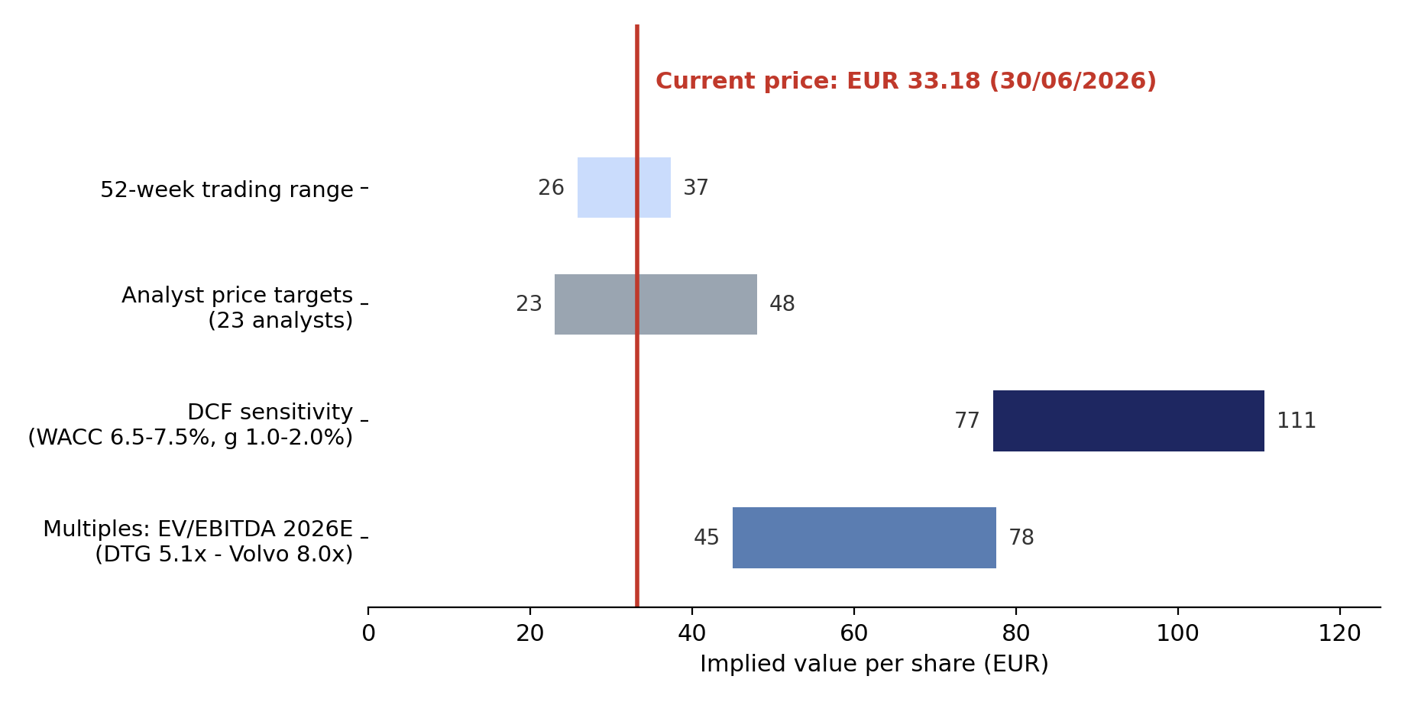
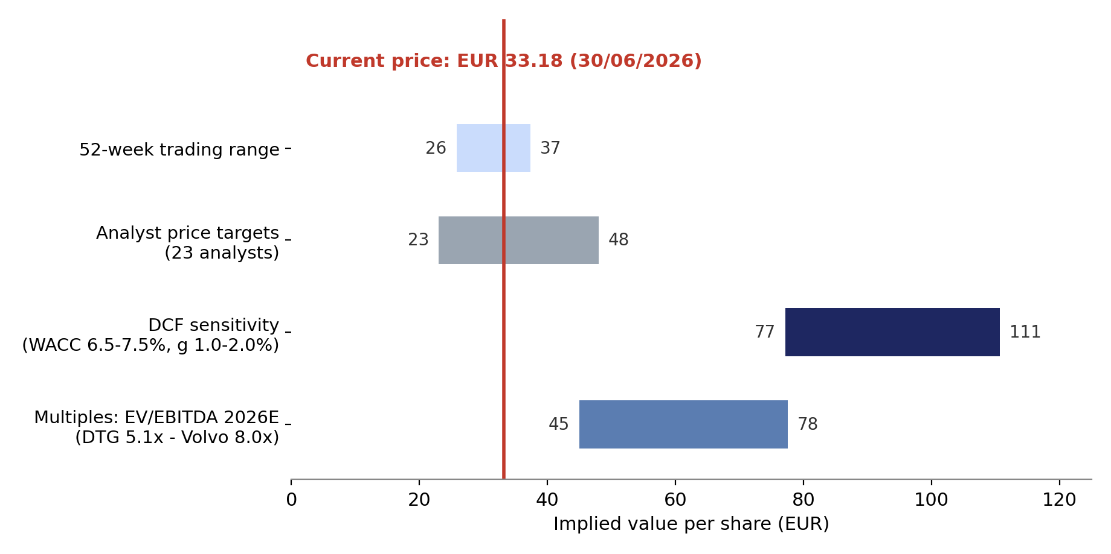
Football field
Overview of valuation results; graph replicated in the Excel file (Football-Field sheet)
The current price sits within the 52-week range and analyst targets, but below every fundamental valuation band. Even the most conservative multiple applied (Daimler Truck EV/EBITDA 2026E of 5.1x) implies ~EUR 45 per share.
Source: own analysis; Bloomberg tearsheet (52w range, analyst targets)
3

Slide 4
Peer group
Peers as provided (Volvo, Daimler Truck); further Bloomberg peers reviewed and mostly excluded
Peer | Comparability to Traton SE | Relevance
Volvo AB (B) | Global truck & bus OEM (Volvo, Renault, Mack), captive finance arm, similar cyclicality and geographic spread; structurally higher margins (15-16% EBITDA vs. Traton 12-14%), industrial net cash | High - included
Daimler Truck | Closest comparable: German HQ, global truck/bus portfolio incl. large North America exposure (Freightliner vs. International), captive FS, similar revenue base (~EUR 46-49bn) | High - included
Iveco Group | Commercial vehicles, but smaller (EUR 13bn revenue), defence carve-out effects; Bloomberg-adjusted EV distorted by industrial net cash - multiples not meaningful | Shown, excluded from ranges
SAF-Holland | Trailer components supplier, not an OEM - different value chain position and margin profile | Excluded
Accelleron | Turbocharger specialist, 28% EBITDA margin, trades at 24x EV/EBITDA - no business overlap | Excluded
(Scania/MAN standalone) | Not listed separately - no market data available | n/a
Selection criteria (per methodology): similar products, region, cyclicality, capital structure incl. captive financial services, accounting (IFRS). Currency: Volvo reported in SEK - converted at EUR/SEK 11.02 for absolute figures; multiples are currency-independent.
Source: Bloomberg XCVA peer set for 8TRA GY; company disclosures
4

Slide 5
Multiples
Trading comps based on Bloomberg-adjusted EVs (captive finance debt excluded)
Company (EURm) | EV | EV/EBITDA LFY | 2026E | 2027E | EV/Sales 2026E | EV/EBIT 2026E | P/E 2026E
Volvo AB (B)* | 56,773 | 8.2x | 8.0x | 7.1x | 1.27x | 11.1x | 15.4x
Daimler Truck | 23,813 | 5.4x | 5.1x | 4.1x | 0.49x | 6.7x | 12.8x
Iveco Group** | 1,241 | 0.9x | 0.8x | 0.7x | 0.08x | n/a | 8.0x
Median (Volvo/DTG) |  | 6.8x | 6.5x | 5.6x | 0.88x | 8.9x | 14.1x
TRATON SE | 20,759 | 3.5x | 3.6x | 3.1x | 0.45x | 6.8x | 8.0x
Implied valuation for Traton | Peer multiple | Traton metric | Implied EV | Implied EUR/share
EV/EBITDA 2026E (median incl. Iveco: 5.1x) | 5.1x | EBITDA 5,719 | 29,349 | 45.05
EV/EBITDA 2027E | 4.1x | EBITDA 6,723 | 27,366 | 41.11
EV/EBIT 2026E (Volvo/DTG median) | 8.9x | EBIT 3,049 | 27,120 | 40.62
EV/Sales 2026E | 0.49x | Sales 45,897 | 22,444 | 31.28
P/E 2026E (equity multiple) | 14.1x | EPS 4.20 | n/a | 59.24
* SEK figures converted at EUR/SEK 11.02. ** Iveco distorted by industrial net cash in Bloomberg EV definition - retained in medians only where it does not bias results, excluded from valuation ranges.
All multiples on adjusted (pre-exceptionals) figures. Traton trades 30-60% below peer medians on every firm value multiple, despite consensus expecting EBITDA to grow from EUR 5.7bn (2026E) to 7.5bn (2028E).
Source: Bloomberg XCVA CompVal & EST reports (03/07/2026); LSEG estimates; own calculations
5

Slide 6
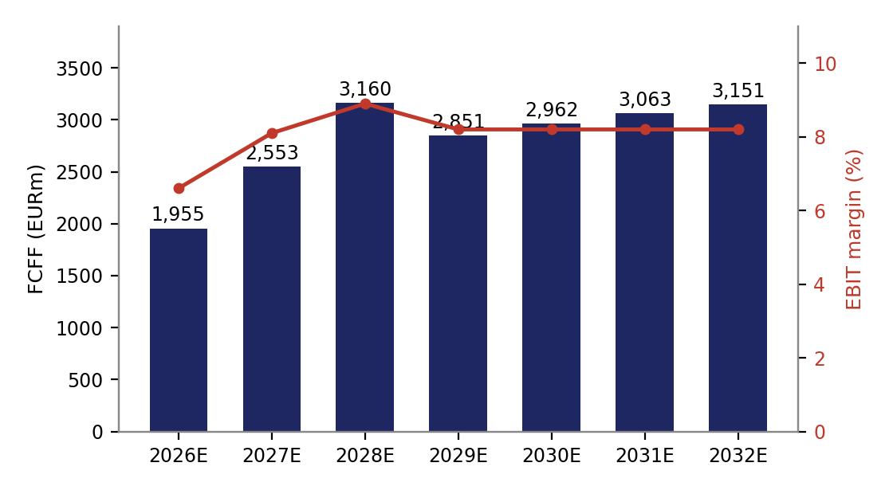
DCF valuation
FCFF discounted at own WACC of 7.1%; half-year treatment of 2026; TV beyond 2032
EURm | 2026E | 2027E | 2028E | 2029E | 2030E | 2031E | 2032E | TV
Revenue | 45,897 | 48,970 | 51,000 | 52,785 | 54,369 | 55,728 | 56,842 | 57,695
EBITDA | 5,719 | 6,723 | 7,486 | 7,390 | 7,612 | 7,802 | 7,958 | 8,077
EBIT | 3,049 | 3,986 | 4,529 | 4,328 | 4,458 | 4,570 | 4,661 | 4,731
EBIT margin | 6.6% | 8.1% | 8.9% | 8.2% | 8.2% | 8.2% | 8.2% | 8.2%
FCFF | 1,955 | 2,553 | 3,160 | 2,851 | 2,962 | 3,063 | 3,151 | 3,226
PV of FCFF (mid-26) | 945 | 2,305 | 2,665 | 2,246 | 2,179 | 2,105 | 2,023 | 37,246
DCF result (EURm)
Sum PV explicit period | 14,466
Terminal value (g = 1.5%) | 58,030
PV of terminal value | 37,246
Firm value | 51,712
Equity value (after bridge) | 44,903
Implied value per share | EUR 89.81
2026 FCFF weighted 50% (valuation date 30/06); cash flows discounted at year-end (t = 0.5 ... 6.5).
Consensus-anchored forecast 2026-28 (Bloomberg/LSEG), growth fading to 1.5% LT; margins held below management target of 9-11% adj. RoS by 2029.
Source: own DCF model (Excel: FCFF & DCF sheet); consensus per Bloomberg/LSEG 03/07/2026
6

Slide 7
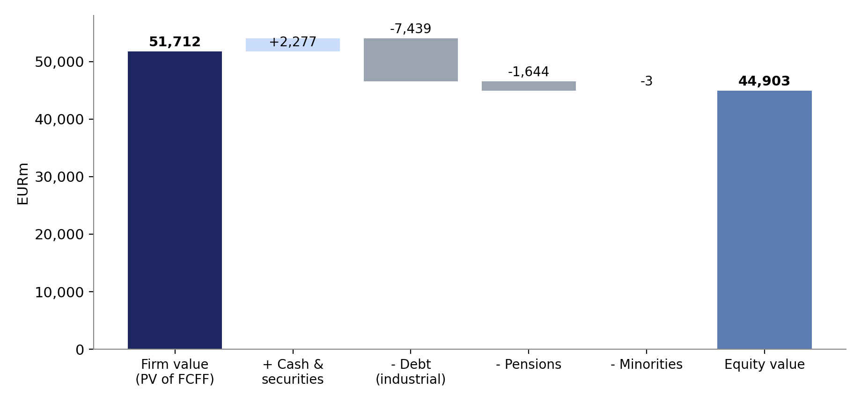
Equity bridge & sensitivities
Captive finance treated as operating: only industrial net debt deducted
Bridge item (EURm)
Firm value | 51,712
+ Cash & securities (Ops & Corp.) | 2,277
- Financial debt (Ops & Corp.) | -7,439
- Pension provisions | -1,644
- Minority interest | -3
Equity value | 44,903
/ 500m shares = EUR/share | 89.81
vs. price 30/06/2026: 33.18 | +171%
Financial Services debt of EUR 19.9bn is NOT deducted - it funds EUR 17.9bn of customer finance receivables and is serviced from FS income (already in FCFF). Deducting group net debt of EUR 24.5bn instead would still imply ~EUR 52/share (+56%).
Implied EUR/share | g 0.5% | g 1.0% | g 1.5% | g 2.0% | g 2.5%
WACC 6.0% | 97.3 | 105.1 | 114.6 | 126.4 | 141.7
WACC 6.5% | 87.8 | 94.1 | 101.6 | 110.7 | 122.2
WACC 7.0% | 79.8 | 84.9 | 91.0 | 98.2 | 107.1
WACC 7.5% | 72.9 | 77.2 | 82.1 | 87.9 | 94.9
WACC 8.0% | 67.0 | 70.5 | 74.6 | 79.4 | 85.0
Even at WACC 8.0% and g 0.5% the DCF implies EUR 67 per share. The market price of EUR 33 corresponds to an implied WACC of >11% - i.e. the market applies a substantial conglomerate/free-float discount.
Source: Traton AR 2025 p.62/65 (net liquidity table, balance sheet); own calculations
7

Slide 8
DCF assumptions
Additional slide: all assumptions, their sources and reasoning
Parameter | Value | Source / reasoning
Revenue 2026-28E | 45.9 / 49.0 / 51.0bn | Bloomberg & LSEG consensus; both agree within 0.6%
Revenue growth 2029-32E | 3.5% fading to 2.0% | Convergence towards LT growth; truck cycle recovery flattens
LT growth (TV) | 1.5% | Long-run GDP growth band 1-3% (methodology deck), chosen conservatively
Gross margin 2029ff. | 21.5% | Consensus 2028 level (21.6%) held; 5Y hist. avg 19.0%
SG&A & other opex | 7.5% of revenue | Implied by consensus GP-EBITDA gap 2028 (7.6%)
D&A / CapEx | 5.8% of revenue each | LSEG capex consensus 26-28 (~EUR 2.7bn p.a.); D/CapEx converges to 1 in TV
delta NWC | 10% of revenue change | Simplification; historical NWC volatile and negative
Tax rate | 30% of EBIT | German statutory rate (KPMG), per template; LSEG effective ~27%
Risk-free rate | 2.9% | 10Y Bund yield as of 30/06/2026
Market risk premium | 4.23% | Given in template (Damodaran 2026, Germany)
Beta (relevered) | 1.31 | Unlevered peer avg 1.07 (Volvo 0.97, DTG 1.17; raw betas Yahoo 5Y monthly, Blume-adjusted), relevered at industrial D/E 0.31
Cost of debt (after tax) | 2.7% | Bund 2.9% + Traton 5Y CDS 95bp, taxed at 30%
WACC | 7.1% | Weights at market values: E 76% / D 24% (industrial net debt 5.2bn)
Valuation-date handling | t = 0.5 ... 6.5 | 30/06/2026 reference date: 50% of 2026 FCFF, year-end discounting
All inputs documented with source comments in the Excel model
8

Slide 9
Additional questions A.1 - A.3
Supplementary analysis; detail tables in Excel sheet "Data Notes (A1-A3)"
A.1 How does the degree and structure of debt across peers influence relative valuation?
All three OEMs run captive finance units, but only Traton carries industrial net debt (EUR ~5bn, legacy of the debt-financed Navistar acquisition); Volvo (SEK 44bn) and Daimler Truck (EUR 9bn) hold industrial net cash. Using unadjusted group debt would inflate Traton EV by ~EUR 22bn and make EV multiples incomparable. On Bloomberg-adjusted EVs Traton still trades cheapest - so leverage explains part, but not all, of the discount. Higher leverage also raises Traton relevered beta (1.31) and its equity risk.
A.2 Do synergies exist between the business lines of Traton Operations?
Yes, and they are central to the equity story: the TRATON Modular System (common base engine, shared powertrains from Scania to MAN and International), the centralized R&D organization since 2025 (segment figures restated accordingly), joint procurement and one group-wide financial services captive. The margin spread - Scania 10.7% adj. RoS vs. International Motors 0.1% (FY25) - shows the synergy potential is not yet realized; capturing it underpins the 9-11% group RoS target for 2029 and our margin recovery path.
A.3 Are there differences between Bloomberg and LSEG data - do they matter?
P&L consensus differs only marginally (revenue 2026E -0.3%, EBITDA 2026E +1.4%, EPS +0.5%) - different contributor panels and adjustment logic; impact on multiples < 2%, immaterial. The decisive difference is in balance-sheet definitions: LSEG reports 2026E net debt of EUR 15.6bn (group definition) vs. Bloomberg EV-adjusted industrial net debt of EUR 4.0bn. The choice moves implied equity value by >EUR 10 per share - the analytical treatment of the captive, not the data vendor, drives the valuation.
Common thread: how one treats TRATON Financial Services (debt, receivables, earnings) is the single most value-relevant analytical choice in this case.
9

Slide 10
Appendix: AI usage
Transparency on how AI (Claude) was employed in this exercise
Step | AI contribution | Human control points
Data extraction | Parsed Bloomberg hardcopies (XCSF/XCVA), LSEG exports, AR 2025 and factsheet; reconciled definitions across sources | Cross-checked totals against source PDFs (e.g. EV composition, net liquidity table)
Model build | Filled the provided Excel template with live formulas, source comments and sensitivity grids | Assumptions reviewed against methodology deck; template structure kept 1:1
External data | Retrieved 10Y Bund yield, EUR/SEK and peer betas via web research | Values documented with source and date in the model
Judgment calls | Proposed captive-finance treatment, half-year discounting, peer selection | Discussed alternatives (group vs. industrial net debt) and quantified their impact
Output | Generated this deck and the football field / bridge charts | Verified zero formula errors; recalculated workbook before submission
Experience: AI was most valuable for fast, source-referenced data extraction from heterogeneous files and for surfacing the Financial Services debt issue early. Limits: consensus data can be silently mixed across vendors - every hardcoded number therefore carries a source comment in Excel so results remain auditable and reproducible by teammates.
10

